Slide 1
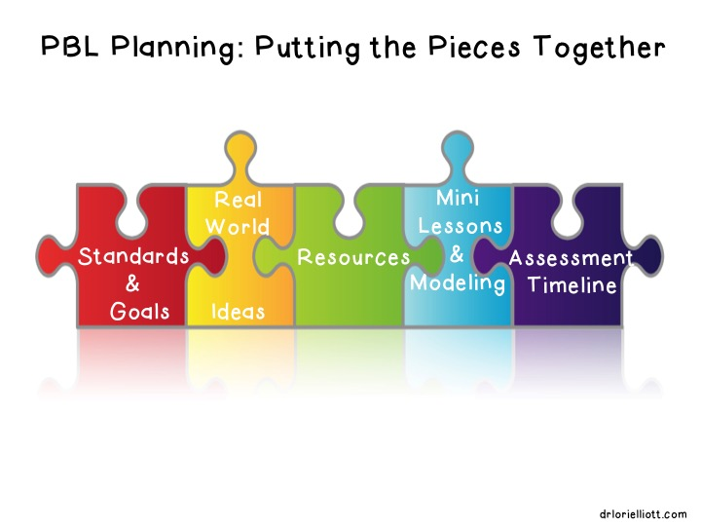
Project based Learning 201
How do I start planning a pbl?

Slide 2
Learning Outcomes
Plan the final product for a PBL.
Create a driving question, entry event, and project summary for a PBL.
Discuss formative and summative assessment during PBL.

Slide 3
Getting Started with PBL
Get into groups of 3. Each person is responsible for reading 2 sections of the article Getting Started with Project-Based Learning by Andrew Miller.
After you are done reading, you will discuss what you read in your group.
https://www.edutopia.org/blog/project-based-learning-getting-started-basics-andrew-miller

Slide 4

Edutopia – 5 Keys to Rigorous Project Based Learning

Slide 5

Begin with the end in mind
The best way to begin planning a PBL is to decide what final product you want your students to create.
By having this final product in mind, you will be able to plan for:
  scaffolding
  resources
  materials
  experts
  formative assessments
  technology support

Slide 6
What is the final product?
Spend 10-15 minutes thinking about the final product and answer the following questions.
  What will all students turn in?
  What do all students have to know for final product? (content standards)
  What do all students have to be able to do for final product? (skills)
  Who will the students present to?

Slide 7

What is a Driving Question?
A driving question is what students should be working to answer or explore during PBL.
- PBL Toolkit

Slide 8
Characteristics of a Driving Question
Creates interest and challenge
Connects the work involved with real-world experiences
Fosters independence and interdependence
Initiates, focuses, and engages inquiry
Clearly communicates the purpose, or main focus, of the project
Is framed according to standards
Acts as a guide for project planning
- International Center for Leadership in Education

Slide 9
Driving Question Generator Chart – PBLWorks
Framing Words | Person or Entity | Action or Challenge | Audience or Purpose
How can … | I We | Build… Create… Make … | Real-world Problem
How do … | We as, (roles) (occupations) | Design … Plan … | For a Public Audience
Should … | (Town) (City) (County) | Solve … | For a School
Could … | (State) (Nation) | Write … | For a Classroom
What … | (Community) (Organization) | Propose … Decide … | For an Online Audience

Slide 10
Driving Question Frames
Can we design a ______ for/to do _____________?
How can we create a _____________ for _____________ to demonstrate ______________?
How can we convince/persuade _______________ that/to ________________?
Can we adapt ______________ to do _____________?
- International Center for Leadership in Education

Slide 11
Driving Question Examples
How can we persuade the principal to extend our recess?
How can we, as NASA scientists, write a proposal that recommends which planet should be explored by the next space probe?
How can we, as responsible citizens, design and operate a business that will contribute to our community?
How can we create a public service announcement for TV showing why the Constitution is still important today?

Slide 12
Write the Driving Question
Take 5-10 minutes to write a driving question for the PBL.

Slide 13

PBL Entry Event
An entry event is typically a 1-2 day event that gets students excited and thinking about the project. In the 5E lesson plan model, it is the engagement.
  Sparks student interest and curiosity
  Begins the inquiry process by leading students to ask questions

Slide 14
Entry Event Video Clip

Slide 15
Entry Event Examples
“Marsbound” entry event was watching The Martian having a class discussion about the difficulties planning a Mars mission and having to consider getting to Mars and surviving on Mars.
“OR Intersection Safety” entry event was to bring in TN State Troopers who investigate traffic collisions. After the guest speakers leave, the class discusses car accidents, who is at fault, and what external factors might contribute to collisions.

Slide 16
Brainstorm the Entry Event
Take 5 minutes and brainstorm the entry event for the PBL.

Slide 17
Why are the Driving Question and Entry Event Important?
If the teacher develops a strong driving question and entry event, students should be able to ask questions and create a list of “need to knows” that will guide their project.
- Buck Institute for Education

Slide 18
How to get students to ask good questions – QFT

Slide 19
Project Summary
A project summary is a paragraph that describes what the project is about and should include:
  the problem or challenge
  student actions that need to be taken
  the purpose/beneficiary of the project

Slide 20
Project summary and Blooms Taxonomy
- International Center for Leadership in Education

Slide 21
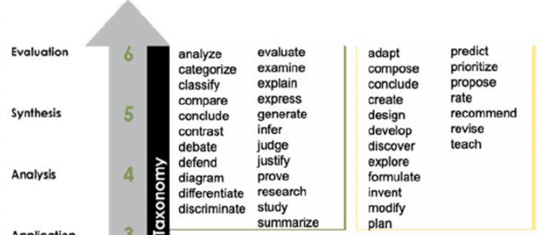
Write the Project Summary
Take 10 minutes and write the PBL project summary. Make sure to include those higher order Blooms Taxonomy verbs.

Slide 22
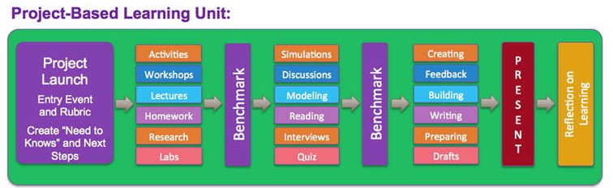
Assessment during a PBL
PBLs should have both formative and summative assessments. Formative assessment should happen regularly throughout. This allows for monitoring and immediate and constructive feedback.
Terry Heick TeachThought

Slide 23
Examples of Formative and Summative Assessment in PBL
Formative (throughout) | Summative (at the end)
Rubrics | Rubrics
Class discussions | Written tests
Checklists | Creative assignments
Questionnaires | Presentations
Journals/progress notes | Portfolios
Peer and Self evaluations | Written reports
Observations | Product
Conferences/interviews | Peer and Self evaluation
- Christine Bauer-Ramazani

Slide 24
Planning for Formative Assessment

Slide 25
Bringing it all together
On the chart paper provided, record the following things:
  Project Title
  Project Summary
  Driving Question (D.Q.)
  Entry Event
  Content (major standards addressed)
  Final product(s)
  Public Audience

Slide 26
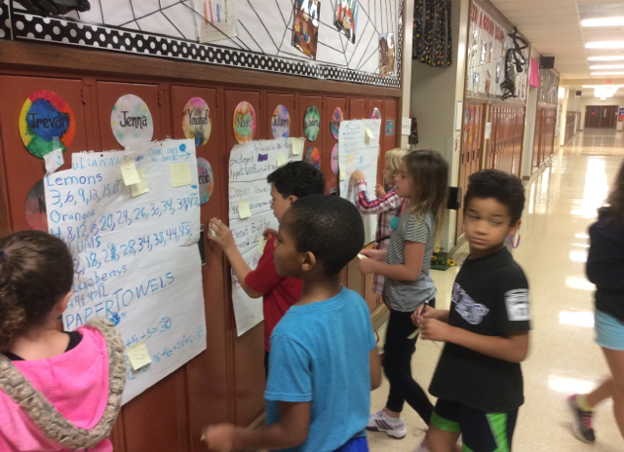
Gallery Walk
Walk around the room looking at the different PBL plans. Use the sticky notes to leave an “I like ….” note and/or an “I wonder ….” note.

