Slide 1
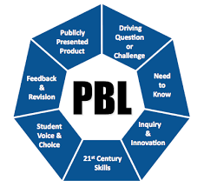
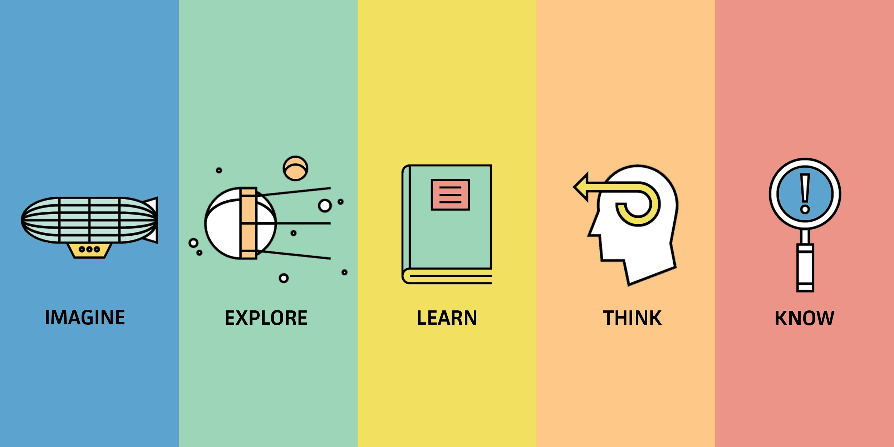
Project Based Learning 101
What is PBL?

Slide 2
Learning Outcomes
I can differentiate between projects and project based learning.
I can explain the 8 PBL requirements.

Slide 3
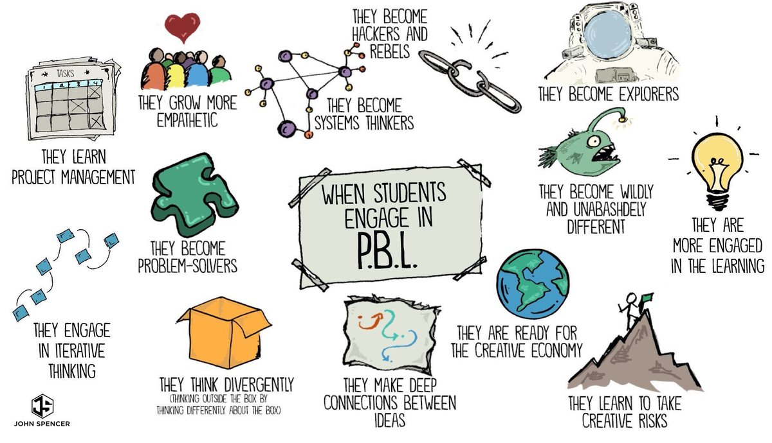
Why is pbl important?

Slide 4
What does the Research say?
Studies comparing learning outcomes for students taught via project-based learning versus traditional instruction show that when implemented well, PBL increases long-term retention of content, helps students perform as well as or better than traditional learners in high-stakes tests, improves problem-solving and collaboration skills, and improves students’ attitudes toward learning (Strobel & van Barneveld, 2009; Walker & Leary, 2009).
The design principles most commonly used in PBL align well with the goals of preparing students for deeper learning, higher-level thinking skills, and intra/interpersonal skills (Condliffe et al., 2016).

Slide 5
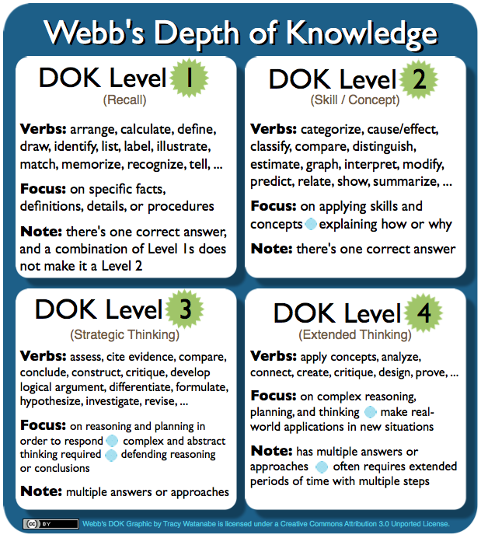
PBL and Webb’s Depth of Knowledge
If a PBL is designed well, it causes students to use DOK Levels 3 and 4.

Slide 6
Project vs PBL activity

Slide 7
Project vs PBL Activity
Part 1: Each group will receive 8 prompts. Decide whether you think each prompt is a project or project based learning.
Part 2: On chart paper, each group describe what qualities they notice about the project based learning prompts. Each group will then discuss with whole group.

Slide 8
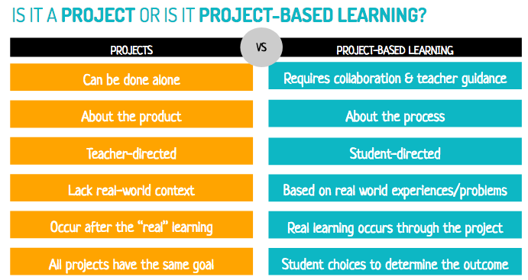
Project vs Pbl
- Gavin Hays

Slide 9
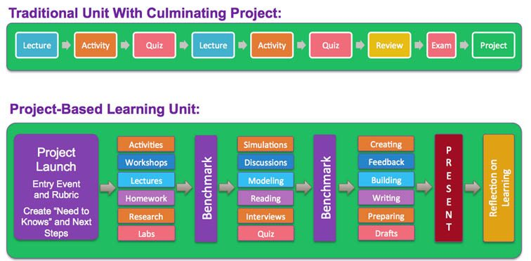
Project vs Pbl
Terry Heick
TeachThought

Slide 10
What is PBL in Oak Ridge?
Project Based Learning is a research-based instructional model where the focus for learning is on the course standards and relevant 21st century work skills such as the 4 Cs of STEM literacy and self-management. It is an opportunity to join forces with other content teachers for STEM-infused lessons. Central to the project is an authentic, real-world challenge. Students should be participants in the decision-making, including how they work and which products they will create. Throughout the project, instructor and peer reviews allow for assessment and feedback related to the effectiveness of the PBL, which improve both process and product. An essential culminating event of a PBL is to have students present their work in a public setting beyond the classroom.

Slide 11

PBL Requirement 1
The project is designed around creating a product that requires extended thinking about academic state standards and utilizes 21st century skills.
The time a PBL takes should be dictated by the number of academic standards and 21st century skills being covered.
  I would strongly suggest starting out with a shorter PBL if you have never done one before.

Slide 12
Taking a look at your standards
Spend 5-10 minutes looking at your academic state standards. Write down standards that students have historically struggled with and/or standards that would allow for extended thinking (DOK level 4).

Slide 13
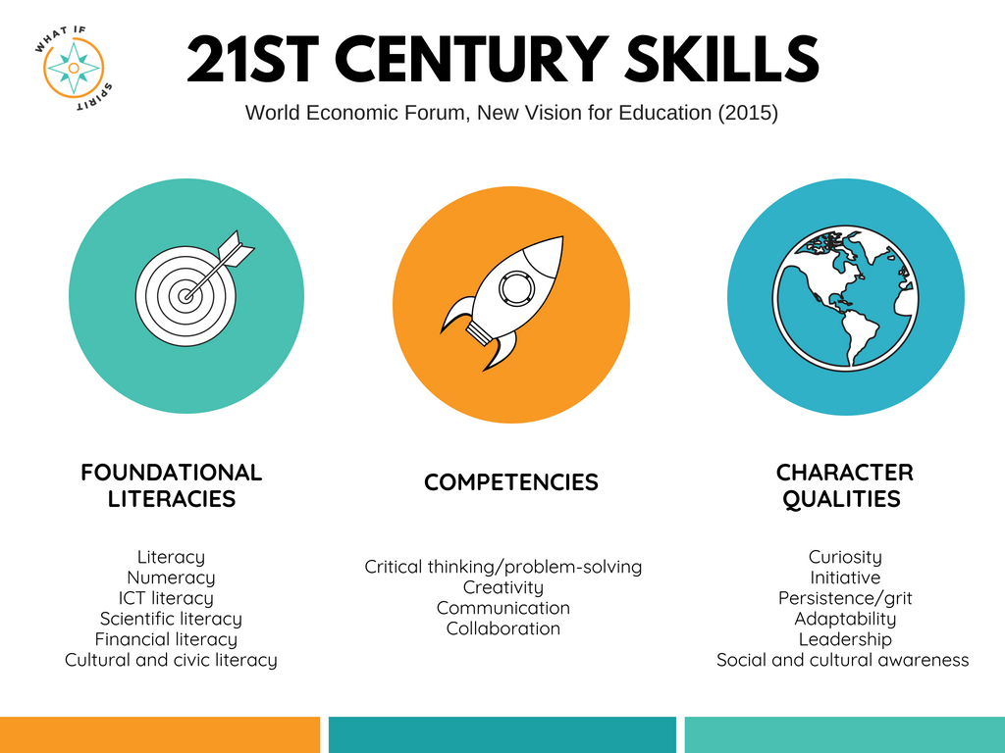

Slide 14
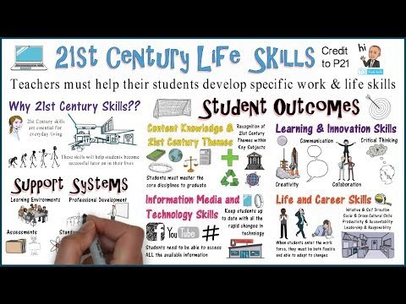
21st Century Learning and Life Skills: Framework Video

Slide 15
21st Century Skills
These skills should be addressed throughout the year. If you only teach students these skills during a PBL, you are going to feel like you are “losing instructional time”. PBL is the time to utilize these skills, not learn about all of them.
Reach out to your ITC to help you plan for technology integration.

Slide 16
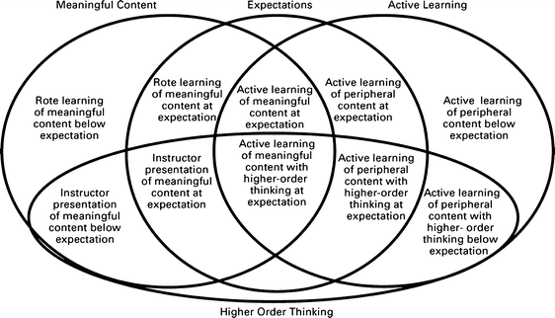
PBL Requirement 2
The project is based on a challenging problem or question that is open-ended, engaging, and aligned to academic standards.
  This is how rigor is introduced into the project.
-Draeger et al. 2013

Slide 17
Rigor
Relevance
- International Center for Leadership in Education

Slide 18
Rigor in PBL Summary
Find all of the high rigor terms in the PBL summary.

Slide 19
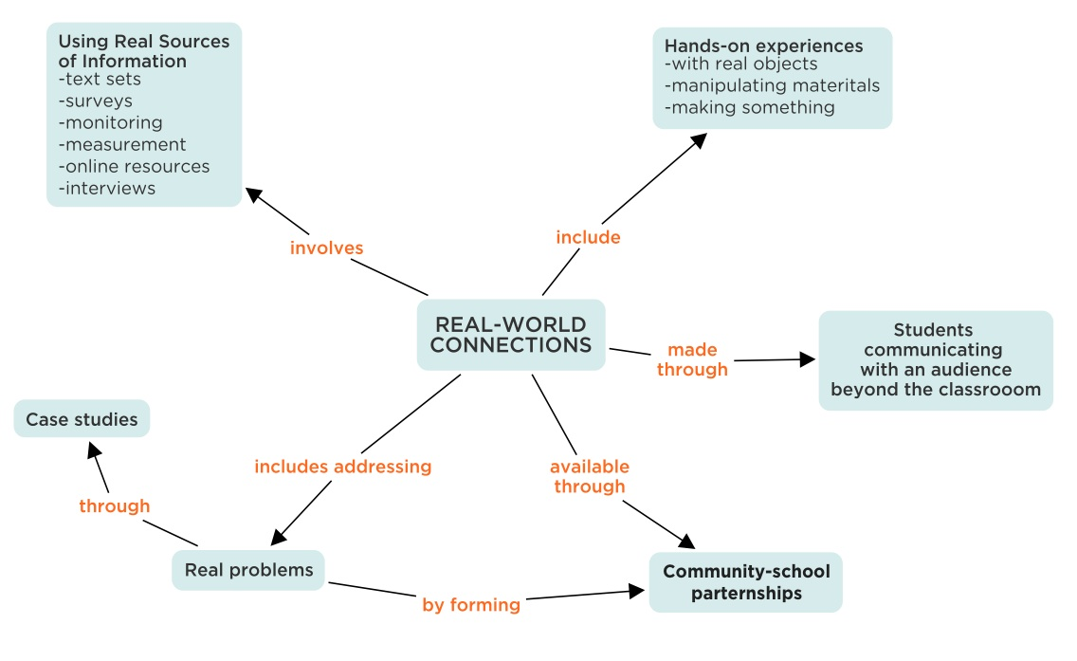
PBL Requirement 3
The project is relevant to students’ lives and makes connections to the real-world.
http://lsf-lst.ca/dots

Slide 20
Reflection
What things do our students find important in the community?
What things do our students find important in society?
Do any of these important community/society topics incorporate your academic content?

Slide 21
Project Examples of Relevance
How do we protect the things and people we care about from collisions?
  In this project, students identify situations in which individuals need protection from collisions or impact and then propose and build protective solutions.
How can we use data to reduce our families’ impact on the environment?
  In this project, students use measurement, data, and fraction concepts to develop, implement, and monitor an action plan for reducing their family’s impact on the environment.
How can we maximize profit in our vending machines while meeting the needs of our entire school community?
  Students identify products that qualify under federal law, research revenue trends, they and explore basic economic principles. They then survey the student body for possible demand, analyze price points, conduct focus groups, and propose a selection they believe will make the most profit while reaching the widest range of students.
www.pblworks.org

Slide 22
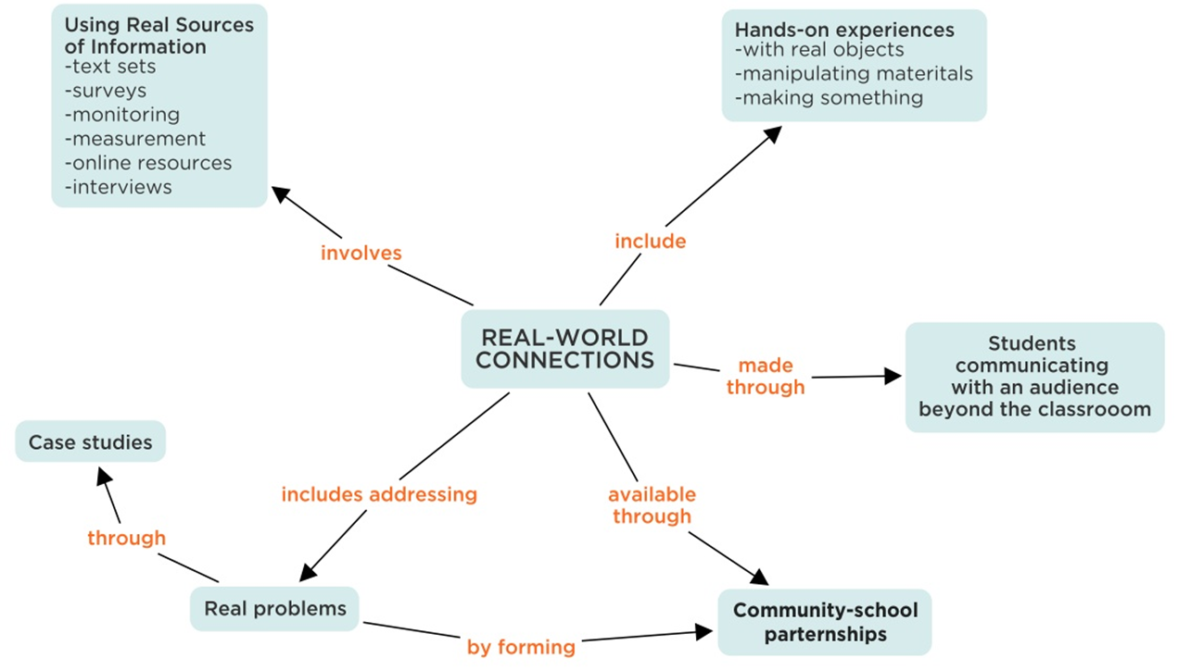
Real-World Connection
On top of making the project relevant to the students’ lives and interests, another way to make the project have real-world connections is to have the students interact with community members and content experts.

Slide 23
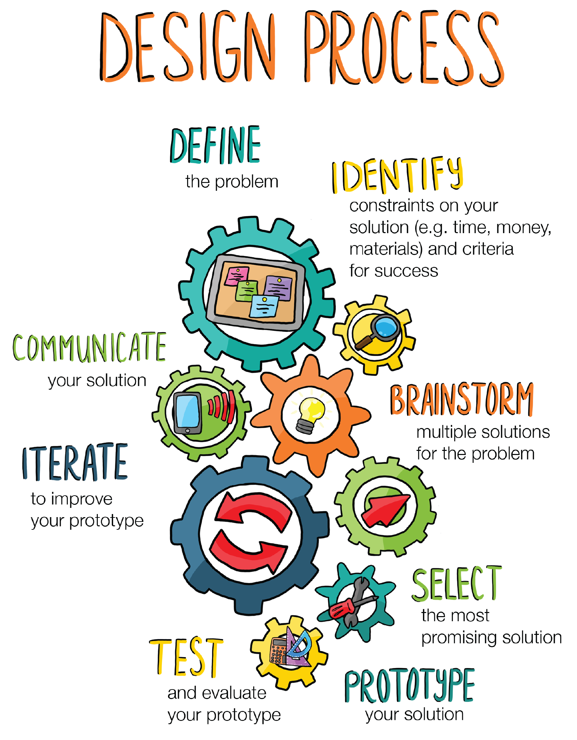
PBL Requirement 4
Students are regularly asked to pose questions, investigate, and develop and evaluate solutions.
  This is sustained inquiry.
https://tnlearn.pbslearningmedia.org/resource/eg-design-process/et-design-process/

Slide 24
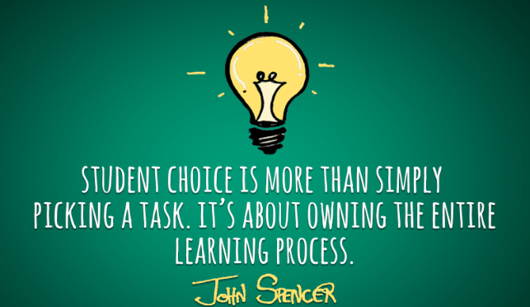
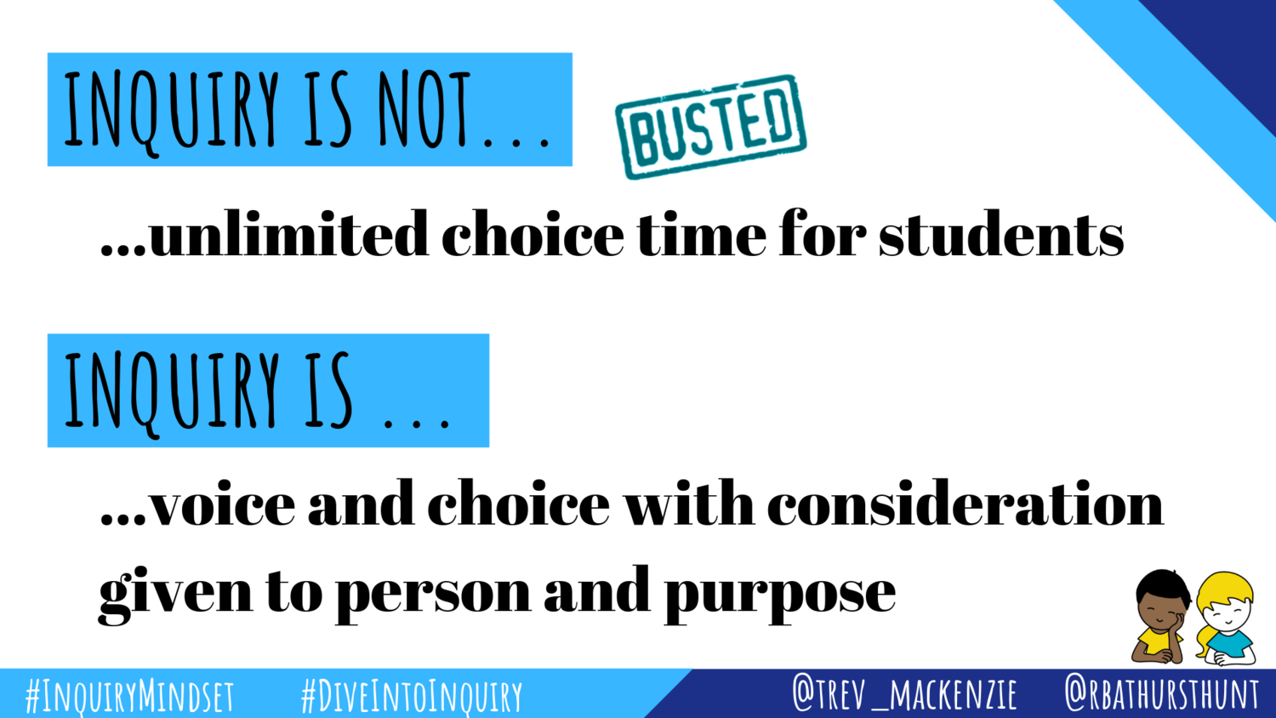
PBL Requirement 5
Students are given opportunities for voice and choice throughout the project and work independently from the teacher at appropriate times.
  This is more than just letting them choose to present with a PPT, Prezi, or WeVideo.

Slide 25
Voice and Choice in PBL
Looking at the Dream Home PBL summary again, how does the PBL allow for student voice and choice?

Slide 26
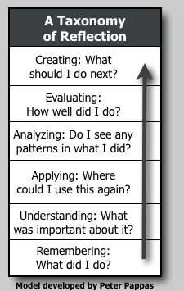

PBL Requirement 6
Students are given opportunities during and after the project to reflect on their learning and project design.

Slide 27
How can we Provide Opportunities for Reflection?
On the sticky notes provided, write down one way you can help facilitate student reflection. Place on the student reflection chart paper.

Slide 28
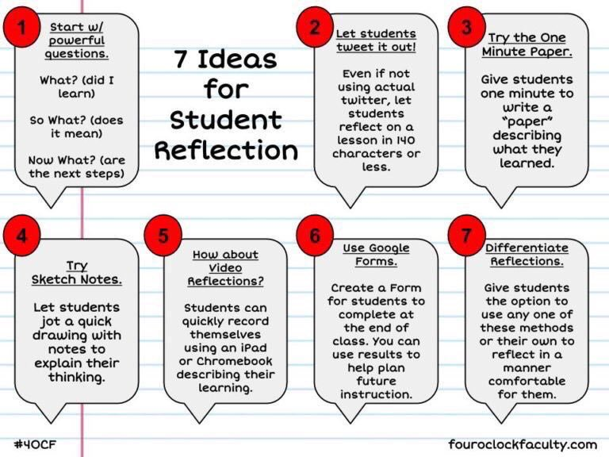
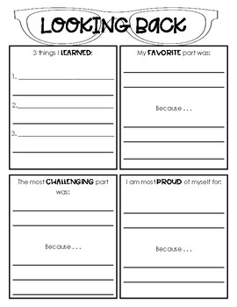
Student Reflection Examples

Slide 29
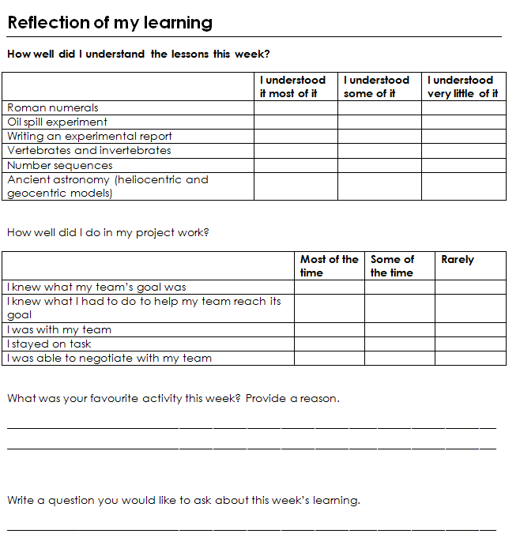
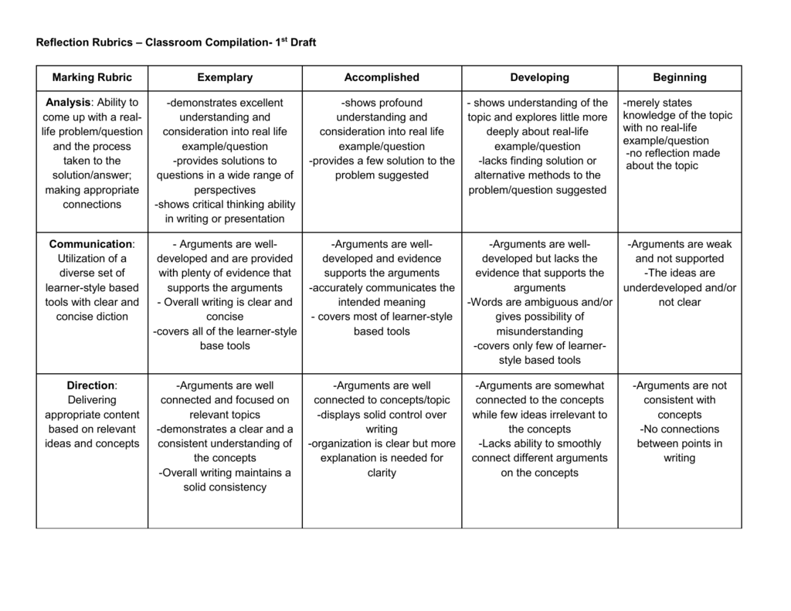
Student Reflection Examples

Slide 30
PBL Requirement 7
Students are given opportunities to receive feedback from several sources and make revisions based on that feedback.
  Gallery Walk
  Student critiques of rough drafts
  Content Expert Feedback
Really important for students to also learn how to give feedback

Slide 31
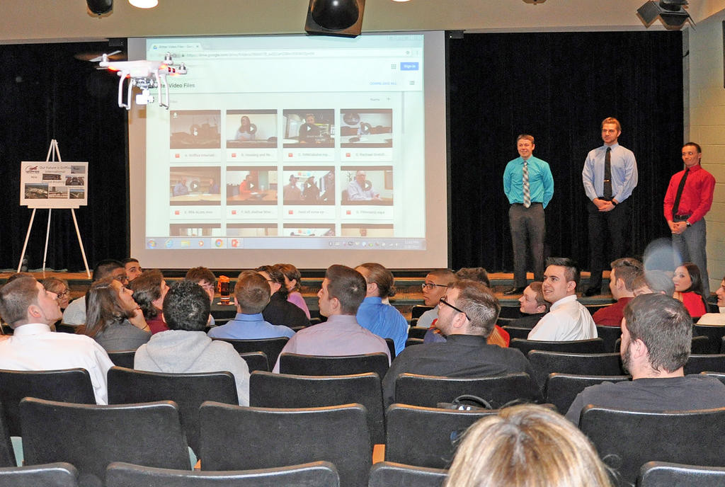
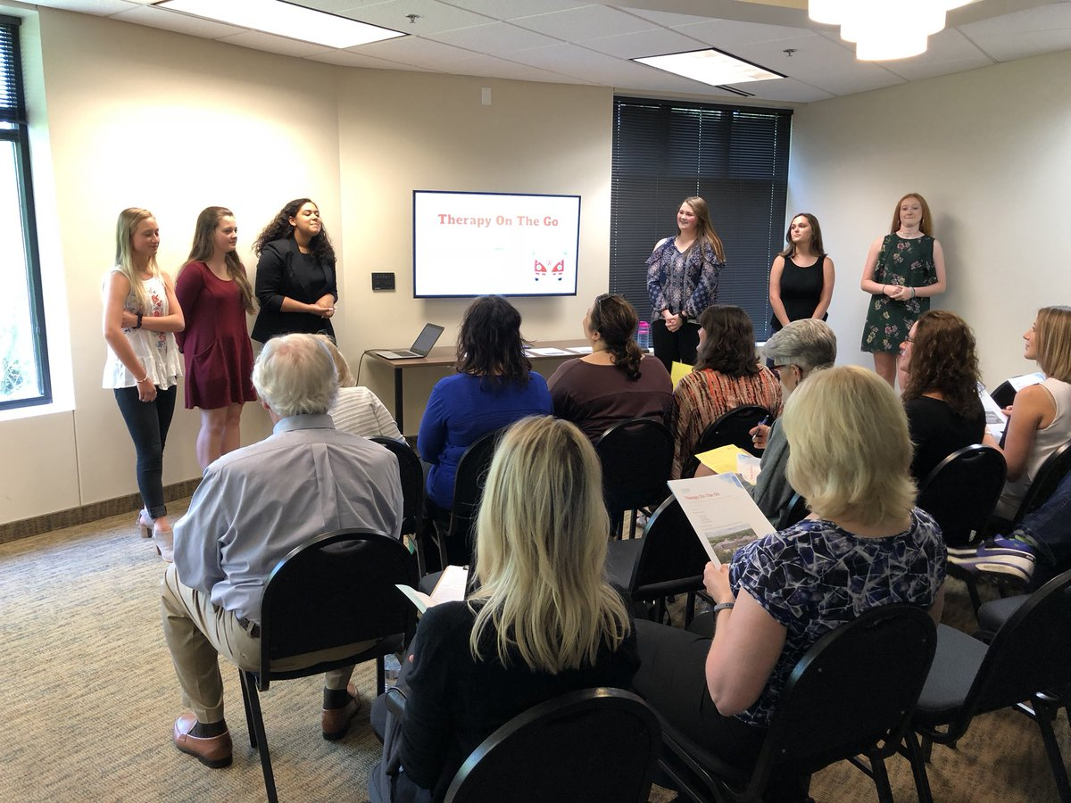

PBL Requirement 8
Students must share product/communicate findings to a public audience.
  A public audience extends outside of their classroom. This is a great motivator in the project.

Slide 32
Public Audience Examples
Content Experts
Community Members
Business/Industry Leaders
Academic Competitions
Conferences
Online Audiences - class website, blogs, etc.
Teachers/Administrators/Central Office/School Board

Slide 33

PBL 101 Reflection
On a sticky note, write down one thing you learned today about PBL that you did not know before or one thing that you had not thought about when planning a PBL before.

