Slide 1
ORS STEM Committee Agenda
November 15, 2021
Portrait of a Graduate (4Cs) Recap
Guest Speaker: Callie Painter discusses how ORS is utilizing Social Emotional Learning (SEL) and Connections to STEM
Schools Discuss STEM Goals for 21-22 and upcoming STEM Opportunities
Community Partner Share Out
Local Needs Assessment Survey

Slide 2
Committee Norms
We will maintain a positive tone at our meetings.
We will remain solutions-oriented at our meetings.
We will begin and end our meetings on time and stay fully engaged throughout each meeting.
We will listen respectfully and consider matters from another’s perspective.

Slide 3
Portrait of a Graduate Recap
Notes:
PoG is comprehensive and progresses from PreK up through 12th grade. STEM education plays an important role in each of the 5 lenses of PoG, but is most prevalent in the 4Cs.

Slide 4
4C’s Scorecard

Slide 5
Cognia STEM Certification Domains
STEM Community looks at equity/inclusion, STEM educator collaboration, STEM community engagement, and STEM leadership.
STEM Learning Culture looks at communication, professional development, project-based and inquiry learning, and self-directed learning.
STEM Experiences looks at STEM extended learning, performance assessment, STEM discipline integration, STEM curriculum organization.
STEM Outcomes looks at STEM content knowledge, STEM skills and competencies, strategic management, and program evaluation.
Notes:
Underlined standards are areas that the STEM Committee is currently helping with or could potentially help out with volunteering, providing real-world experiences, spreading resources equitably across the schools, etc.

Slide 6
Guest Speaker: Callie Painter
ORS Student Success Coordinator clpainter@ortn.edu

Slide 7
What is SEL?
SEL is the process through which all young people and adults acquire and apply the knowledge, skills, and attitudes to develop healthy identities, manage emotions and achieve personal and collective goals, feel and show empathy for others, establish and maintain supportive relationships, and make responsible and caring decisions.

Slide 8
SEL and Workforce Preparation
Consider what it means for students to be prepared for the future. What will students need to know and be able to do to become college, career, and community ready?
What social emotional skills do you feel have been lacking in recent applicants, new hires, or students?

Slide 9
SEL and STEM Connections
SEL
STEM
Self-Awareness
Self-Management
Relationships
Responsible Decision-Making
Social Awareness
Brainstorming, creativity, growth mindset
Research, design, overcoming obstacles
Collaboration, communication
Problem-solving
Empathy, understanding, design thinking

Slide 10
Character Strong Curriculum Overview

Slide 11
Save the Date!
January 27
Virtual Mental Health 101 for ORS Parents and Guardians at 6:00
February 17
Navigating Life in the Digital Age Presentation for ORS Parents and Guardians at ORHS at 6:00
Guest Speaker: Ben Tracy
Notes:
-Show censored social media posts from students at your school
-Ben’s story of losing a great job due to inappropriate social media he made as a teenager
-Trends of employers and colleges looking at social media
-How social media impacts mental health
-How to report cyberbullying, threats, and online predators
-Positive use of social media for teenagers
-Ben’s story of losing a great job due to inappropriate social media he made as a teenager
- Most popular social media apps for teenagers
-Best practices and tools for monitoring kids online
-How to limit screen time
-How to report cyberbullying and online predators

Slide 12
School STEM Goals and Upcoming STEM Opportunities

Slide 13
Oak Ridge Schools Preschool 21-22 STEM Goals
Learn the guidelines for STEM Certification and evaluate our program to determine areas of strength and areas of refinement in regards to the guidelines. Intentionally pursue opportunities for growth in the areas of refinement.
Increase intentional STEM learning across all classrooms and celebrate the growth.

Slide 14
Glenwood STEM Goals 2021-2022
Maintain STEM certification and be prepared to undergo the recertification process by collecting artifacts and data. (Keeping good records on the front end to avoid scrambling in the future.)
70% of 3rd and 4th grade students proficient or advanced on TNReady Math (up from 58% in 2021).
Involve stakeholders in STEM activities and decisions
70% of 3rd and 4th grade students proficient or advanced on TN Ready Science (up from 56% in 2021).

Slide 15
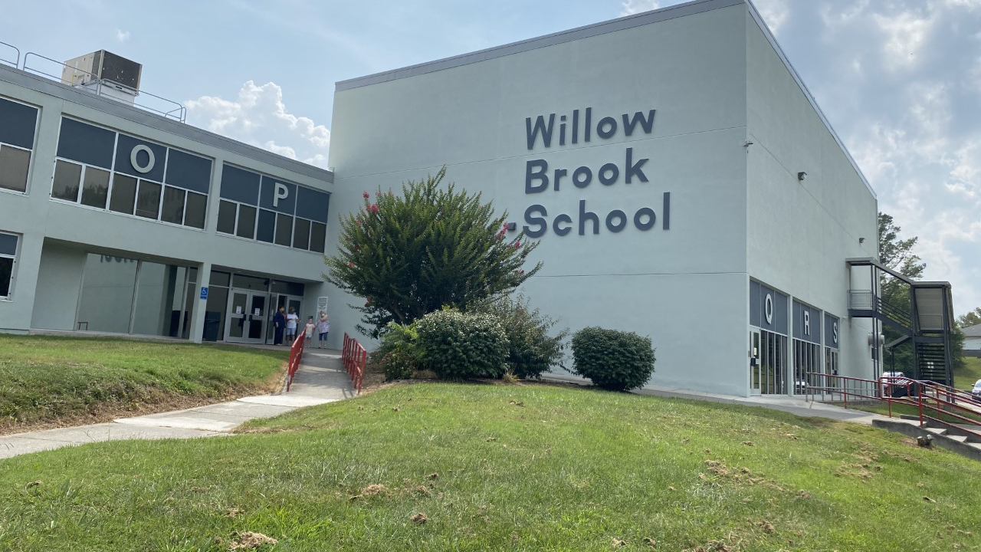
*Willow Brook Elementary will start and strengthen a robotics club. *Willow Brook Elementary will implement capstones for each grade level that coordinate with current curriculum and show growth of students in the 4Cs.
2021-2022

Slide 17
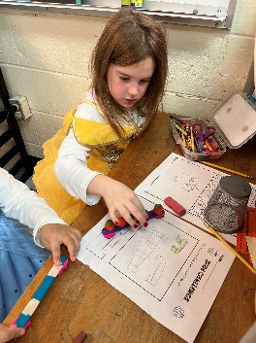
Woodland Elementary STEM Goals
Create System for Collection of STEM Artifacts, Evidence, and Data
Establish Expectations and Accountability for STEM Experiences in the Classroom
Host Staff Wide STEM Professional Development to Enhance STEM Knowledge
Create a Solid Foundation for STEM Student Experiences and Refine the Artifact Collection Process

Slide 18
Jefferson Middle School 21-22 STEM Goals
Plan and hold 2 STEM Days during school hours December 17 and TBD in spring.
STEM Night on March 10, 2022

Slide 19
Robertsville Middle School
Implement:
ORS STEM/PBL 4Cs Rubric
PBL Professional Development
Capstone
Data Collection:
Enrollment Data
Programming Data
Survey Data
STEM at RMS
Portrait of a Graduate
Capstone
STEM Night
PBLs
Clubs

Slide 20
ORHS STEM Goals 2021-2022
-ORHS will accomplish Cognia STEM Recertification
-Every ORHS PLC will submit a PBL plan
-ORHS will host a STEM night
-ORHS will incorporate 4Cs Rubrics into all classrooms

Slide 21
Community Partner Share-Out
What can ORS do to better prepare our students for the community and local industry?
What can you do to help ORS better prepare our students?

Slide 22
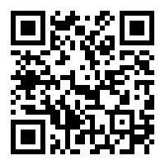
Survey: Please Help
Beginning in 5th grade, we offer STEM, Aeronautics, Business Education, and Career Exploration. These articulate into our high school programs of study. We need your input for continuous improvement in these areas.
There are 5 simple questions:
What can Oak Ridge Schools do to better prepare our students for our local industry workforce?
What can our local industry leaders do to better support our schools in this preparation?
What careers will be in demand in our area, based on knowledge you have of local industry?
What soft and technical skills will students need to thrive in our local industry?
What is the projected salary range for high-demand, high-skill jobs that you mentioned above?
https://www.surveymonkey.com/r/QYWMMRG

Slide 23
Next meeting is Tuesday, January 18
Agenda and Team link to be emailed in January

